Slide 1
File Transfer Protocol
A NUSP Mini Project
By
Bhavanaagamya B S
Bhavya M
C V Vishwas
Chandan lal

Slide 2
Contents
Introduction
Problem Statement
Design
Requirements
Applications

Slide 3
What is FTP
The File Transfer Protocol (FTP) is a standard network protocol used for the transfer of computer files between a client and server on a computer network. FTP is built on a client-server model architecture using separate control and data connections between the client and the server.
FTP is a client-server protocol where a client will ask for a file, and a local or remote server will provide it.
File Transfer Protocol (FTP) is an application layer protocol which moves files between local and remote file systems

Slide 4
Problem Statement
The objective of this project is to implement the File Transfer Protocol using socket programming in java.

Slide 5
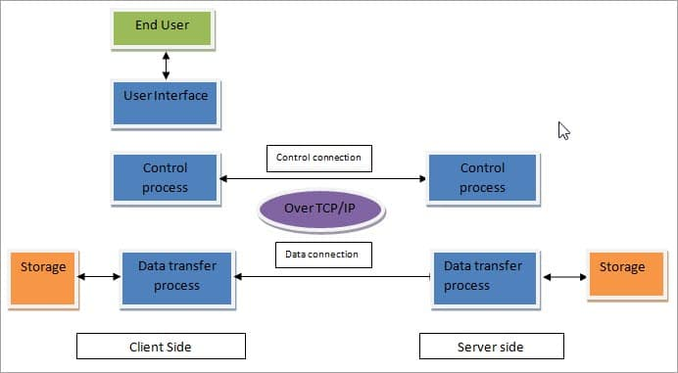
Design

Slide 6
Requirements
Hardware Requirements
I3 or higher processor
Laptop/Personal Computer
4 GB RAM
Software Requirements
Ubuntu OS
Java Compiler

Slide 7
Applications of FTP
FTP finds application in many day-to-day business operations that span business-to-business and peer-to-peer data transfer use cases, including:
Organizations use FTP to allow employees to share files across different locations and branch offices.
Employees use FTP to securely share files with coworkers and external business partners.
IT teams use FTP to transfer data back to DR (disaster recovery) sites.
Webmaster teams use FTP to transfer Web pages, Web application files, and images to their Web server.

Slide 8
Thank You

